Slide 1
MEC101
Mechanical Sciences-I
Chapter 6: Stresses & Deflection in Beams

Slide 2


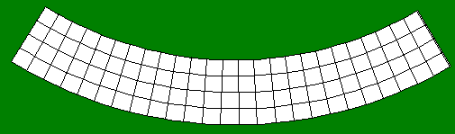
Pure Bending

Slide 3
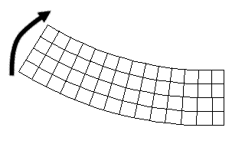

Equilibrium: Resistive Moment
Is this positive or negative?

Slide 4
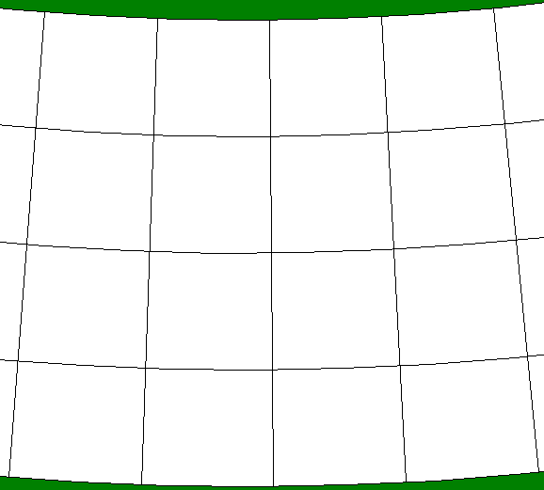
Origin of Resisting Moment
Compression near top
Extension near bottom

Slide 5
Origin of Resisting Moment...
Extension near top
Compression near bottom

Slide 6
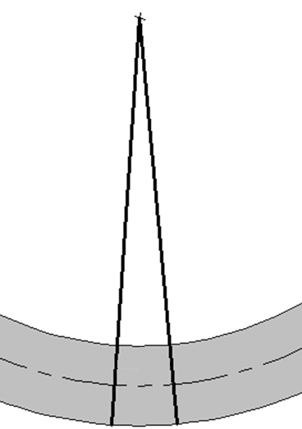
Longitudinal Strain
Plane sections remain plane

Slide 7
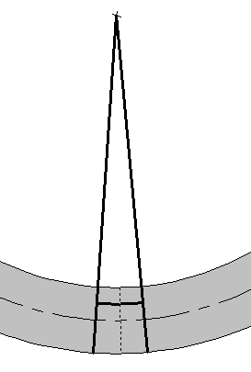
Longitudinal Strain
y
ε_{x} = (IJ – MN)/MN
= [(ρ – y)ΔΦ – ρΔΦ]/ρΔΦ
= -y/ρ
x
z
ρ
ΔΦ
ρ - y
Neutral Axis
I
J
y
M
N

Slide 8

Longitudinal Stress
ε_{x} = -y/ρ
σ_{x} = -Ey/ρ
-ve
Compression
Tension
+ve

Slide 9
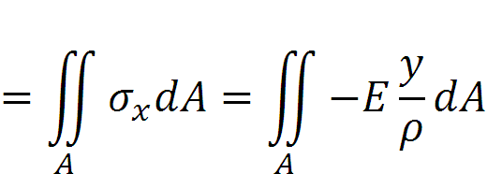
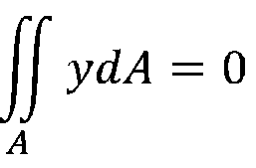
Equilibrium
-ve
y
+ve
ΣF_{x} = 0
Neutral axis passes through the CENTROID

Slide 10
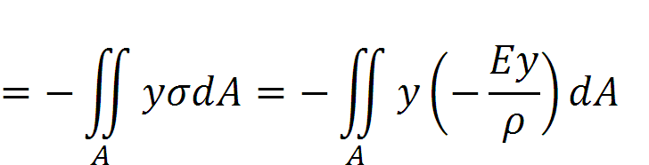

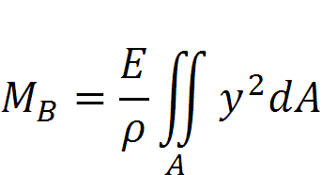
Equilibrium...
-ve
y
+ve

Slide 11
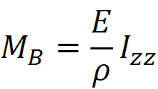
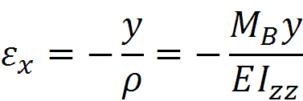
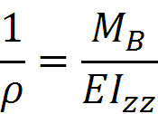
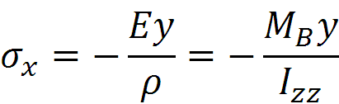
Equilibrium...
y

Slide 12
Stresses
y
Maximum tensile stress occurs on extreme fibres

Slide 13
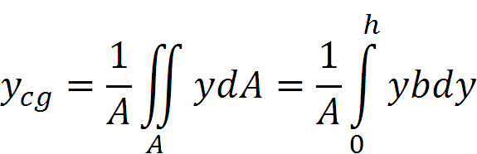
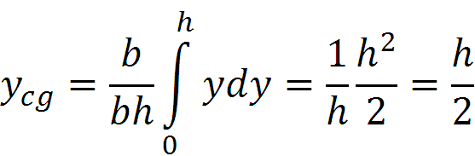
Rectangular Section
y
Location y_{cg} of centroid =
dy
h
z
b

Slide 14
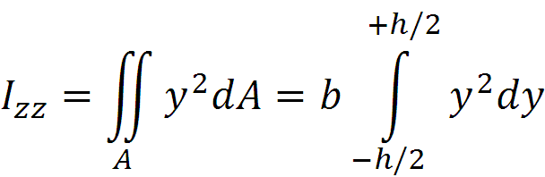
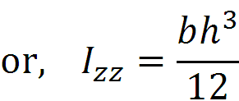
Rectangular Section
y
With y measured from centroidal axis:
dy
h/2
z
b

Slide 15
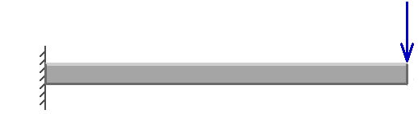
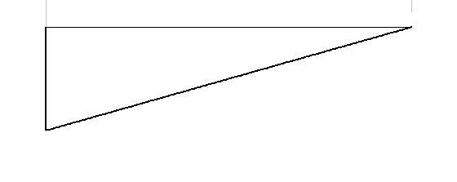
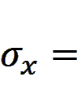
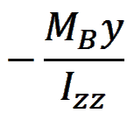
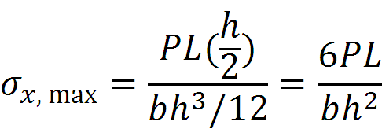
Example: Cantilevered Beam
P
P
PL
h
b
x
BMD
- PL

Slide 16
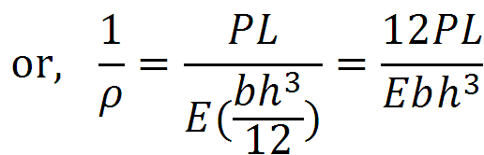
Example: Cantilevered Beam
P
P
PL
h
b
x
BMD
- PL

Slide 17
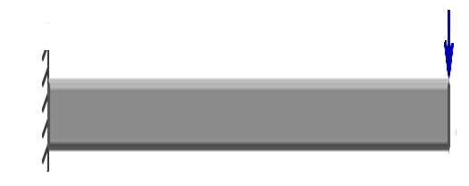
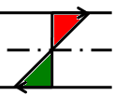

Cantilevered Beam
h
b
b
h

Slide 18
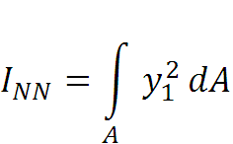
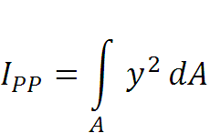
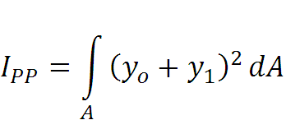
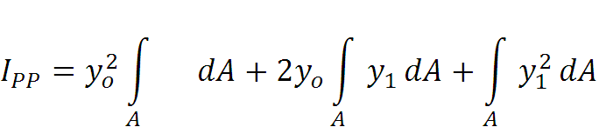

Parallel Axis Theorem
b
h
y₁
N
N
y₀
P
y
P
I about NA is the minimum

Slide 19

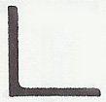

Introduction to Beams
Common shapes are
I Angle Channel
Common materials are steel and wood

Slide 20
Introduction to Beams
The parallel portions on an I-beam or H-beam are referred to as the flanges. The portion that connects the flanges is referred to as the web.
Web
Flanges
Web
Flanges

Slide 21
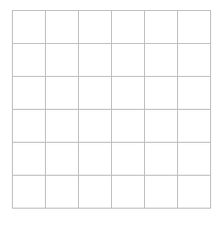
T-Section
y
Area A = 20
1
y_{cg} = (1/20)(5×12 + 2×8)
= 76/20 = 3.8
2
z
To find I_{zz} about the NA, we first find the I of each of the two areas about their own centroids, and the use parallel axis theorem to shift to the actual NA.

Slide 22
T-Section
y
Centroidal axis of Section 1
1
I of Section 1 about its own CA
= 6×2³/12 = 4
2
This transferred to NA (at a distance of (5 – 3.8) = 1.2 is = 4 + 12×(1.2)² = 21.3
z
Similarly, I of Section 2 about its own CA = 2×4³/12 = 10.7.
This transferred to NA (at a distance of (3.8 - 2) = 1.8 is = 10.7 + 8×(1.8)² = 36.6
Thus, I for the section is 21.3 + 36.6 = 57.9 units

Slide 23
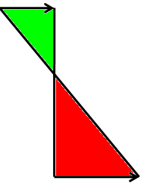
T- Section...
For +ve M_{B}: Max tensile stress is much more than the max compressive stress

Slide 24
I-Section
y
Area A = 28
1
y_{cg} = 0
2
3
z
To find I_{zz} about the NA, we first find the I of each of the three areas about their own centroids, and the use parallel axis theorem to shift to the actual NA.

Slide 25
I-Section
y
Centroidal axis of Section 1
1
I of Section 1 about its own CA
= 6×2³/12 = 4
2
This transferred to NA (at a distance of (5 – 3) = 2 is = 4 + 12×(2)² = 52
3
z
Similarly, I of Section 2 about its own CA (which is also the NA) = 2×2³/12 = 1.3.
Thus, I for the section is 2×52 + 1.3= 105.3 units

Slide 26
I-Section
Since the area of this I-section is 28, we scale the width by a factor of 20/28 to make this of the same area.
It is easy to see that I_{zz} will reduce by this factor.

Slide 27
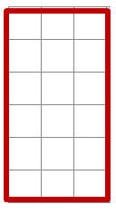
Comparison with Rectangular Section of the Same Area
 | Rectangular | T-Section | I-Section
Max +ve y | 3 | 2.2 | 3
Max -ve y | 3 | 3.8 | 3
Value of I | 58.9 | 55 | 71.2

Slide 28
Comparison with Rectangular Section of the Same Area
 | Rectangular | T-Section | I-Section
Max +ve y | 3 | 2.2 | 3
Max -ve y | 3 | 3.8 | 3
Value of I | 58.9 | 55 | 105.3

Slide 29
Angle-Section
Ay_{cg} = (2×4)×4 +(6×2) ×1
A
y_{cg} = 44/20 = 2.2
B
I_{zz} = (2×4³)/12 + 8×1.8²
+ (6×2³)/12 + 12×1.2² = 158.4
Let each square be 5 mm × 5 mm.
Then I_{zz} = 9.9× 10⁻⁸ m⁴

Slide 30
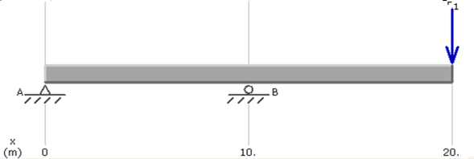

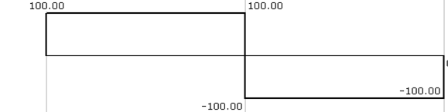
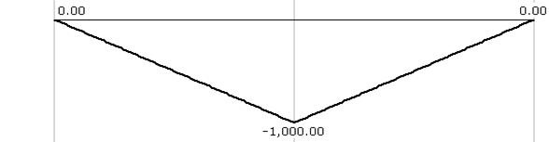
Example
100
200
100
Max stresses occur at the second support. The beam will tend to break here.

Slide 31
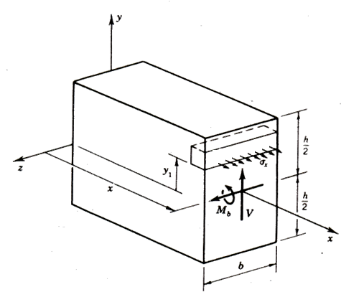
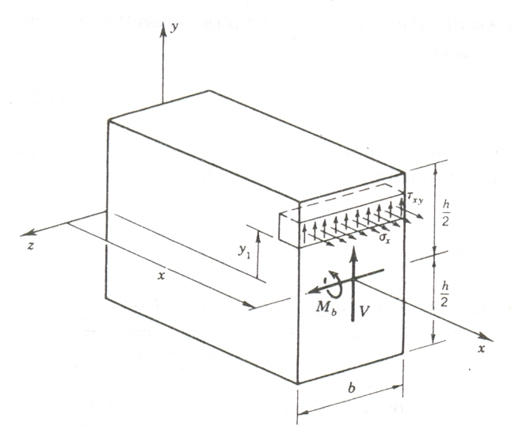
Shear Load

Slide 32
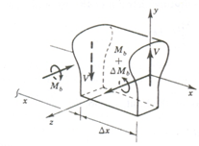
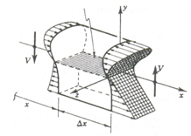
Shear Load
Neutral Plane

Slide 33
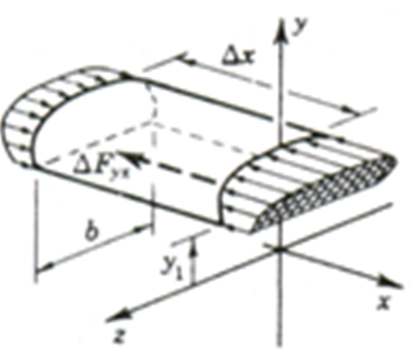

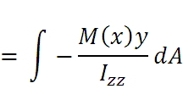
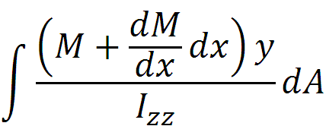
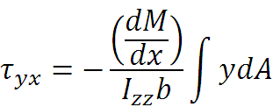

Calculation of Shear Stresses
Δx
τ_{yx}

Slide 34
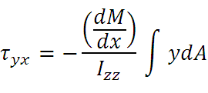

Calculation of Shear Stresses
What is ?
Δx
M
M +
dx
V
Taking moment:
dx + Vdx = 0
or = - V

Slide 35
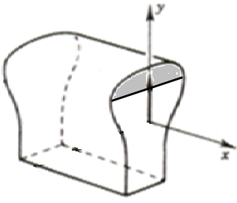
Shear Stresses
= VQ/I_{zz}b
Where Q is the first moment of area (about NA) ABOVE the level where τ_{xy} is to be determined.
NA

Slide 36
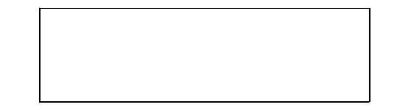
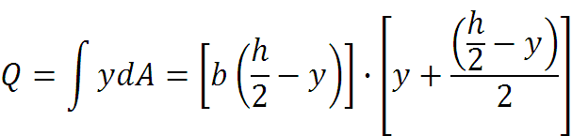
Example: Cantilevered Beam
P
P
PL
y
h
x
SFD
- P
b
x
BMD
- PL
Q at y = 0 is bh²/8; at y = h/2 is 0.

Slide 37
An Example...
Parabolic distribution

Slide 38

Another Example
τ_{xy} = VQ/I_{zz}b

Slide 39




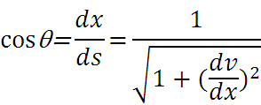



Curvature
θ
dv
θ

Slide 40







Deflection
P
P
PL
x
SFD
- P
x
BMD
- PL
M_{B} = -P(L – x)

Slide 41
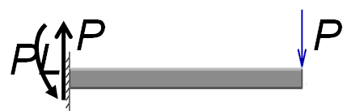



Maximum Deflection
-v

Slide 42






Simply- Supported Beam
for x < L/2,
+PL/4
for x < L/2, M = (P/2) x
for x > L/2, M = (P/2)x - P(x – L/2) = 0

Slide 43
Simply- Supported Beam
Similarly, for x > L/2
There will now be four constants and we need four boundary conditions!
+PL/4
for x < L/2, M = (P/2) x
for x > L/2, M = (P/2)x - P(x – L/2) = 0

Slide 44




Simply- Supported Beam
And two compatibility conditions
+PL/4
for x < L/2, M = (P/2) x
for x < L/2, M = (P/2)x - P(x – L/2) = 0

Slide 45


Deflections
Δ_{max} (l/2) | Pl³/48EI
Δ_{x} (x < l/2) | Px(3l² – 4x²⁾ /48EI
M(x) | Wx(l – x)/2
Δ_{max} (l/2) | 5Wl⁴/384EI

Slide 46

Deflections
Δ_{max} | Wl⁴/8EI
Δ_{x} (x) | W(x⁴ – 4l³x + 3l⁴) /24EI

